Slide 1
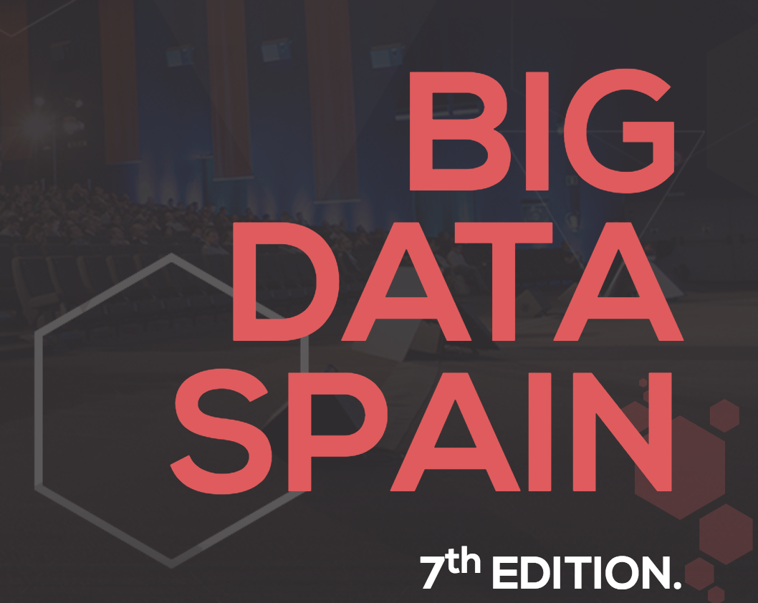

How to Build High Performing Weighted XGBoost Classifier for Real Life Imbalance Data Set.
@BigDataSpain
Alok Singh
Principal Engineer
IBM Center for Open Source Data & AI Technologies

Slide 2
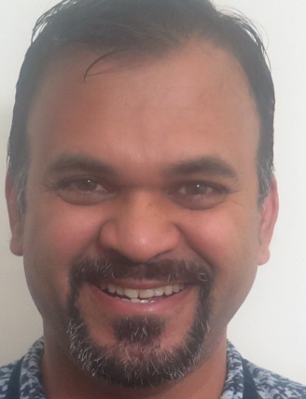
About Presenter
Alok Singh
Alok Singh is a Principal Engineer at the IBM CODAIT (Center for Open-Source Data and AI Technologies). He has built and architected multiple analytical frameworks and implemented machine learning algorithms along with various data science use cases. His interest is in creating Big Data and scalable machine learning software and algorithms. He has also created many Data Science based applications.
Interests: Big Data, Scalable Machine Learning Software, and Algorithms.
Contact:
url- http://codait.org
email- singh_alok@hotmail.com
github -https://github.com/aloknsingh

Slide 3

Agenda
IBM and Data Science
Why this talk?
Tools and Technology
Overview and flow of workshop
Scikit-learn based ML pipeline
Various Model evaluation techniques
Iterative Model training
Hands on tutorial for building predictive models for imbalance datasets
Setup
Tutorial
Q/A

Slide 4


IBM Commitments to Open Source AI and Data Science
+
Notes:
4 Slides time:3-4 mins

Slide 5


CODAIT
codait.org
codait (French)
= coder/coded
https://m.interglot.com/fr/en/codait
Center for Open Source Data and AI Technologies
CODAIT aims to make AI solutions dramatically easier to create, deploy, and manage in the enterprise
Relaunch of the Spark Technology Center (STC) to reflect expanded mission

Slide 6
CODAIT
codait.org
Center for Open Source Data and AI Technologies
Code - Build and improve practical frameworks to enable more developers to realize immediate value
Content – Showcase solutions to complex and real world AI problems
Community – Bring developers and data scientists to engage with IBM
Improving Enterprise AI lifecycle in Open Source

Slide 7

IBM Watson Studio for Data Science Experience
ALL YOUR TOOLS IN ONE PLACE
IBM Watson Studio Data Science Experience is an environment that brings together everything that a Data Scientist needs. It includes the most popular Open Source tools and IBM unique value-add functionalities with community and social features, integrated as a first class citizen to make Data Scientists more successful.
datascience.ibm.com
Notes:
The IBM Watson Studio Data Science Experience is an environment that brings together everything that a Data Scientist needs. It includes the most popular Open Source tools and IBM unique value-add functionalities with community and social features, integrated as a first class citizen to make Data Scientists more successful.
The URL for DSX is datascience.ibm.com
We believe that a winning platform for data science needs to integrate with both open source and value-add tooling. We also plan on integrating popular tools from strategic partners so that we can better serve the needs of our clients and better fit into their tooling preferences and underlying infrastructure. The goal is to have all of the tools that a Data Scientist needs in one place, thereby making it easier for data science teams to learn, create, and collaborate.

Slide 8

IBM Watson Studio Click here to watch video
Notes:
IBM Watson Studios Data Science Experience has been developed based on interviews with hundreds of Data Scientists and the feedback of thousands of users.
Watch this design video at https://www.youtube.com/watch?v=1HjzkLRdP5k to learn more about how and why we created the Data Science Experience.

Slide 9

Why This Talk for building Predictive Models for Imbalance Datasets?

Slide 10
Challenges in building ML model
Non Representative data
Insufficient data
Poor quality data
Imbalance data set
Irrelevant features
Over fitting the model on data
Under fitting of the model on data
Whether model will generalize or not

Slide 11
Imbalance Dataset: A Story …
We get real life labeled data sets from our clients and we are asked to build a classifier to predict if someone will buy our products.
We clean our data and build latest state of art ML model for it.
We run cross validation and feature engineering to select best model.
We evaluate model and it doesn’t perform good on test dataset but in theory it should perform good.
We explore more and finds that the number of labeled samples where someone buys the product is very less say 1 % and our classifier didn’t learn since it thought that those product that was bought was noise.
Notes:
For context on why XGBoost and class imbalances are a relevant topic, it’s important to know that most of the real life data set contains very small amount of samples of interest i.e in our case, the number of people who purchased Bank’s term deposit financial product are very little compare to the number of people who didn’t purchase. And when we build supervised machine learning model on this kind of dataset. Our model doesn’t perform good on the dataset since while training it thinks that since it is predicting most of the negative samples right, it is doing great. However, as the user, we are mostly interested in the positive samples.
We will see now to solve those problems.

Slide 12
What we will do in this workshop …
Data Set Description.
Exploratory Analysis to understand the data.
Use various preprocessing to clean and prepare the data.
Use naive XGBoost to run the classification.
Use cross validation to get the model.
Plot, precision recall curve and ROC curve.
We will then tune it and use weighted positive samples to improve classification performance.
We will also talk about the following advanced techniques.
Oversampling of minority class and Undersampling of majority class.
SMOTE algorithms.
Notes:
All those terms will be explained in later slides in details

Slide 13

Tools and Technologies

Slide 14
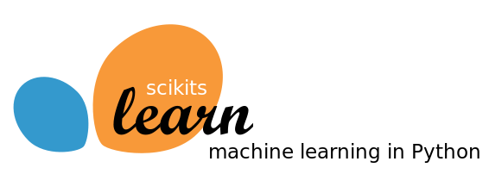
Scikit-Learn
Library of ML models and utilities
Has many out of box ML models and utilities that works out of box
Python is now very popular among data-scientists.
XGBoost allows one to tune various parameters.
Has pipeline, estimators and transformers concept that allows one to build big ML apps
Well Documented and a lot of examples and support group.

Slide 15

Why and What of XGBoost.
XGBoost is extreme gradient boosting algorithm based on trees and tends to perform very good out of the box compare to other ML algorithms.
XGBoost is popular amongst data-scientist and one of the most common ML algorithms used in Kaggle Competitions.
XGBoost allows one to tune various parameters.
XGBoost allows parallel processing.
Works very well with Python and Scikit Learn.
Notes:
4 Slides => 3 mins

Slide 16
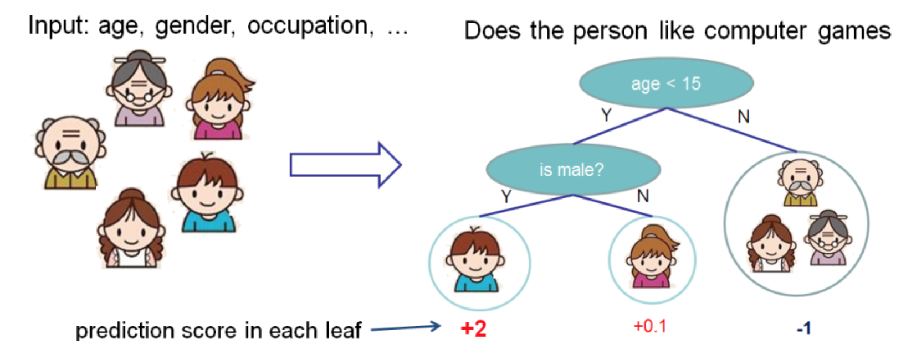
XGBoost
Source: Official Tutorial => https://xgboost.readthedocs.io/en/latest/tutorials/model.html
Notes:
Time: 1 min
Explain: XGBoost is ensemble method .
Lets consider the CART algorithms,
Here we build a tree

Slide 17
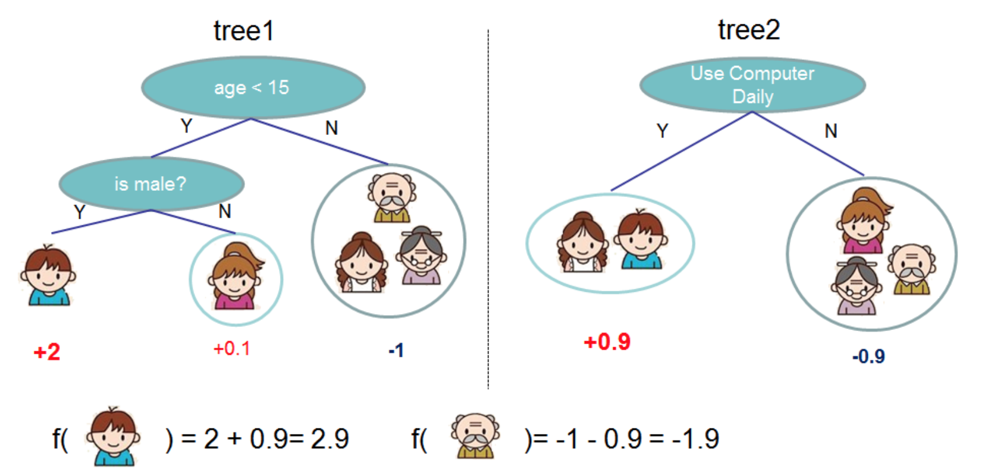
XGBoost (continue …)
Source: Official Tutorial => https://xgboost.readthedocs.io/en/latest/tutorials/model.html
Notes:
Explain: However in the XGBoost instead of one tree or many tree as in random forest we have a sequence of trees which iteratively refine itself.

Slide 18
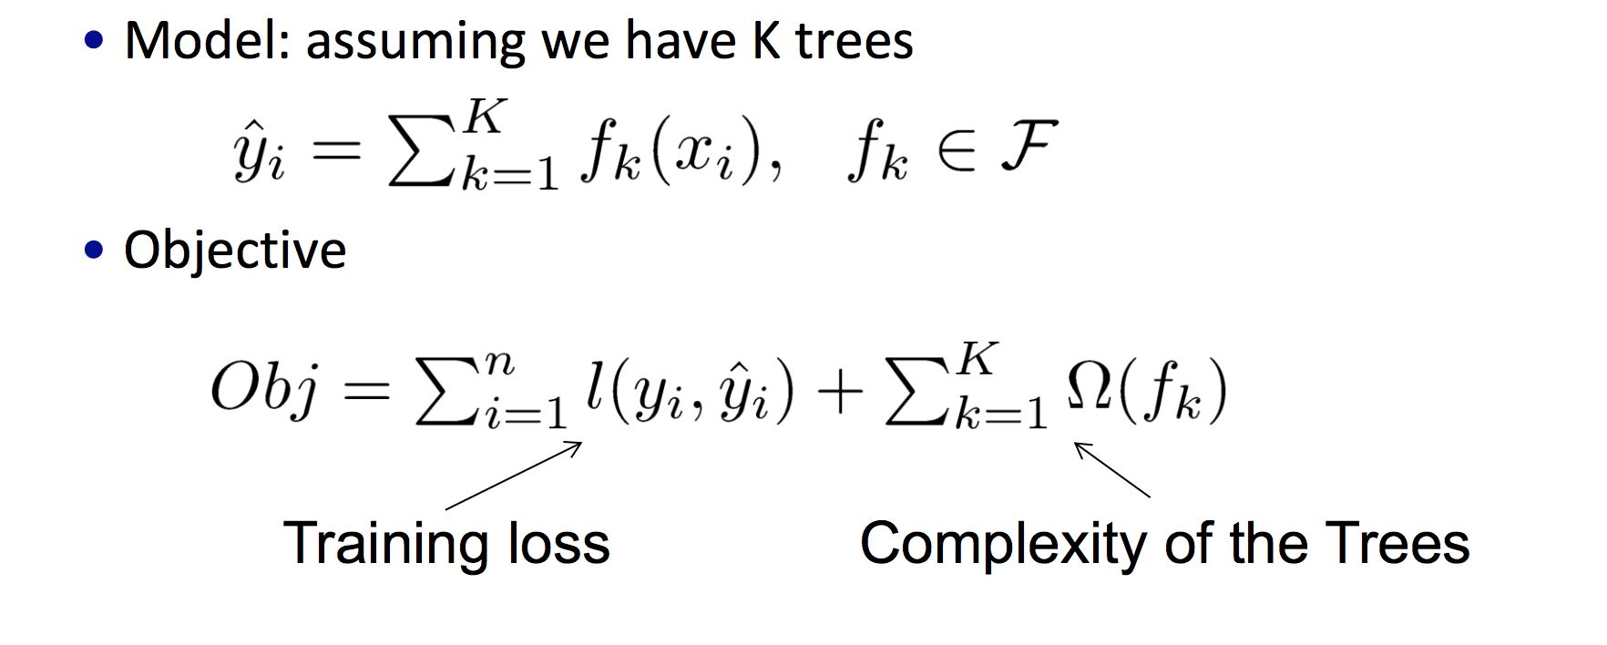
XGBoost (continue …)
Source: From the XGBoost Author=> https://homes.cs.washington.edu/~tqchen/pdf/BoostedTree.pdf
Notes:
Mathematically it is the refined of each steps by series of function approximate for previous errors
Note that at each steps we change complexity of tree
Recommend to go through the whole tutorial.

Slide 19

Overview of the this tutorial
Notes:
In this section , we will look into various aspect of the workshop that we will cover , also we will go in details in some of the concepts that will be used heavily in the notebooks.

Slide 20
Scikit-based ML flow
Read input
Data Exploration
XGBoost based iterative model training
Scoring/Generalization
Feature Engineering
Preprocessing
Tutorial ML Flow
Notes:
Time (3 m)
Explain: how we will go through each steps in shorts

Slide 21
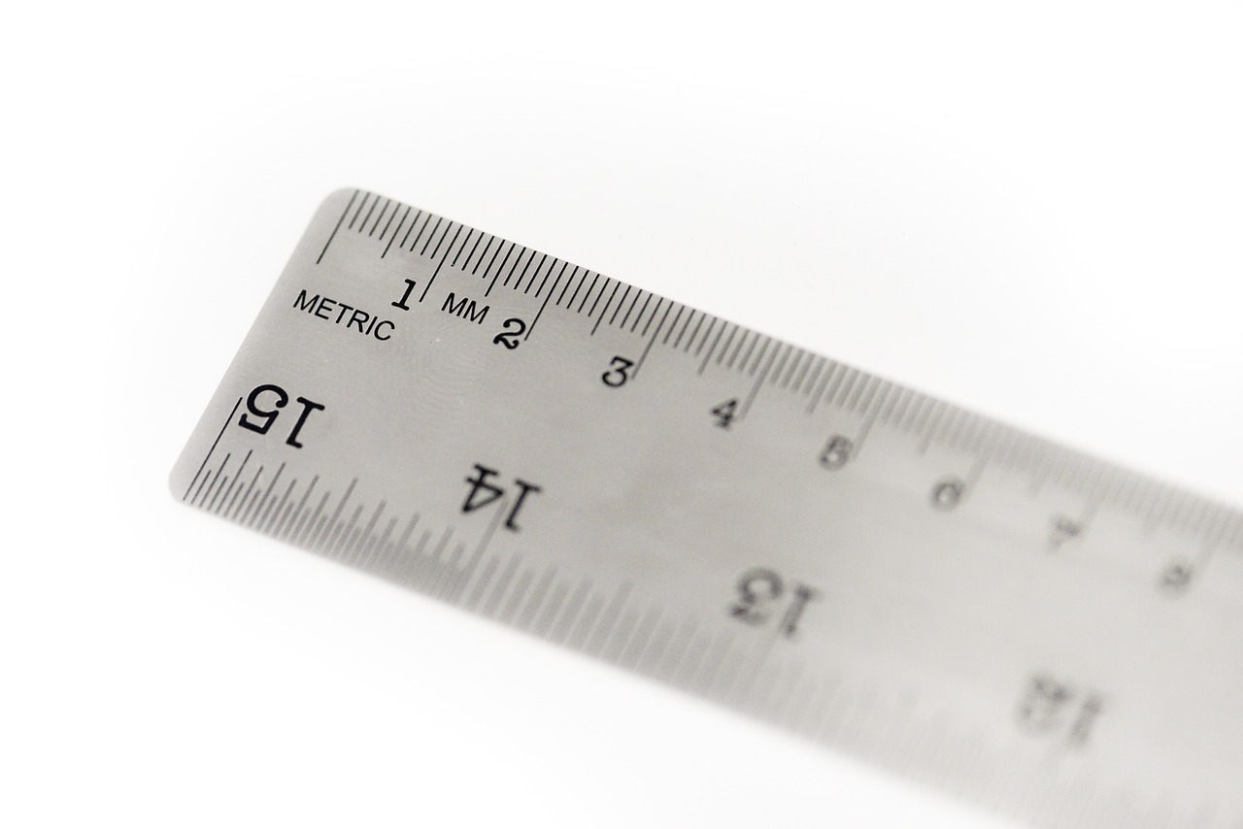
Metrics for Model Performance.
To come up with the best model, we should evaluate model performance for comparison among various models. There are many ways to evaluate the model performance for classification.
Before we go into model training we will understand various model evaluation criteria
1) Accuracy Score
2) Confusion Matrix
3) ROC curve
4) Precision Recall Curve

Slide 22
Confusion Matrix
Actual Positive
Actual Negative
TP
(True Positive)
FP
(False Positive)
Predicted
Positive
FN
(False Negative)
TN
(True Negative)
Predicted
Negative

Slide 23

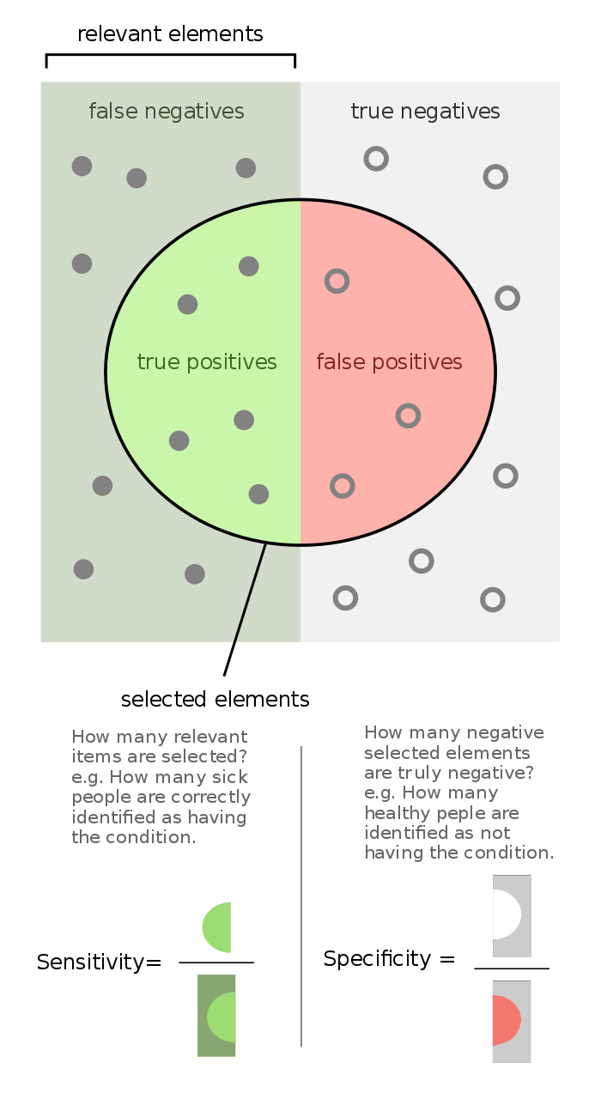
Receiver Operating Characteristics (ROC)
TP/(TP+FN)
TN/ (TN+FP)
By FeanDoe - Modified version from Walber's Precision and Recall https://commons.wikimedia.org/wiki/File:Precisionrecall.svg, CC BY-SA 4.0, https://commons.wikimedia.org/w/index.php?curid=65826093
Notes:
Explain(3 min)
Talk about history
Each of 3 curves and how it relates
How shifting in 1 curve effect 3 curve.
Lets see what is ROC curve? We can get the TP, TN, FN, FP from confusion matrix as explained in previous section. ML models also gives us the probability of a sample being a positive or negative. This allows us to make the better decision.
For ROC curve, we use
TPR : True Positive Rate (aka Recall) = sensitivity i.e number of samples, model correctly classifies a positive sample as positive.
FPR : False Positive Rate (aka 1- Specificity) i.e number of samples, model incorrectly classifies a negative sample as positive.
obviously, we would like to have higher TPR and lower FPR.

Slide 24
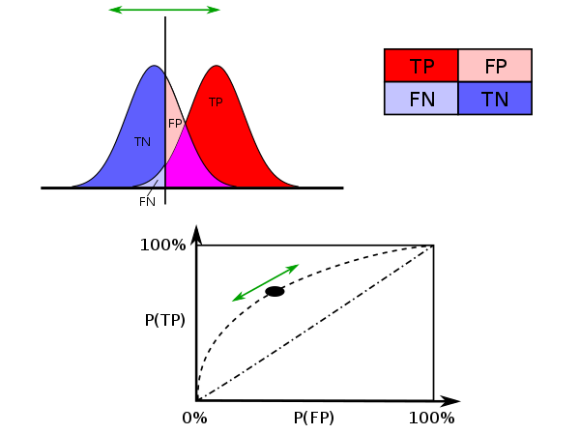
ROC (continue…)
Source:Wikipedia By Sharpr - Own work, CC BY-SA 3.0, https://commons.wikimedia.org/w/index.php?curid=44059691
Notes:
Each of 3 curves and how it relates
How shifting in 1 curve effect 3 curve
For example, consider two predicted positive samples, one with 0.55 probability and other with 0.95 probability. These samples are considered positive because by default the threshold is 0.5. If we use the threshold of 0.6 then first sample will be negative and the second will be positive.
In short, the values of TP, FP, TN, FN will change depending on the threshold.
Thus we see that by adjusting the threshold, one can change the model's performance and for binary classification this adjustment is very often done. When we adjust the threshold, the value of TPR and FPR will also change, as they are function of TP, FP, TN, FN and when we plot TPR vs FPR for various threhold, we get the ROC curve.
For a model to have best performance, we would like to have model rank a randomly chosen positive sample higher than a randomly chosen negative samples and this is what we call Area Under the Curve (AUC) metric.

Slide 25
Precision-Recall Curve(PR Curve)
TP/(TP+FP)
TP/(TP+FN)
By Walber [CC BY-SA 4.0 (https://creativecommons.org/licenses/by-sa/4.0)], from Wikimedia Commons
Notes:
Time: 3min for 2 slides
Why PR is better than ROC for certain data
Explain the difference from ROC and definition of PR curve.
Examples like documents retrieval and others more details in notebooks
We have a good measure for measuring model performance using ROC curve. However, when we have the class imbalances, ROC curve doesn't perform good. To understand that see the equation for TPR and FPR and in the case of class imbalances, the number of positive samples are quite few and the number of FN relative to TP is quite more and hence if there is any change in TP or FP, that will be very small compare to TN and FN and hence even if I get get improvement ROC curve won't be able to capture it.
Hence we use another metrics which is precision and is defined as TP/(TP+FP). We note that since it is the odd ratio of TP and FP both of them are sensitive to changes in positive samples.This matrix is very useful for measuring the performance in case of class imbalance.

Slide 26
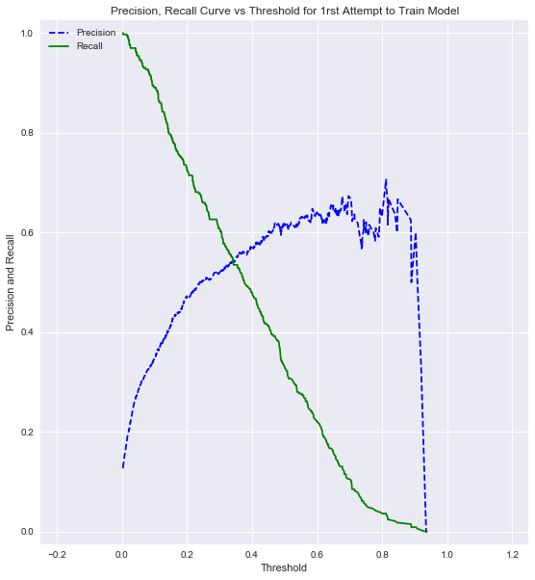
PR Curve (Continue…)
Notes:
An Example of plot
Inverse relationship between p and r
So there must be some middle point for best

Slide 27
F1-Score
Since there is the inverse relationship between precision and recall .
You increase one , other will go down and vice versa.
And hence if we want to do justice to both the metrics, we usually use the combination of both .
We use harmonic mean to combine them.
F1Score = Precision*Recall/(Precision+Recall)

Slide 28
Which Metrics to use for Imbalance Datasets?
We will use precision recall with varying threshold to find out the best threshold
But we should note that Precision and recall have inverse relationship and hence if we want high precision then we should be fine with low recall and vice versa.
There are many applications where high precision might be desired. For example if we train a model to detect safe website for kids. It's ok to reject many safe website (low recall) as long as we correctly reject bad website (high precision)
However for our applications, i.e bank client's CD subscription prediction, higher recall is desirable. Since it is perfectly fine to have false client i.e model predict client will accept the subscription but will actually decline it, as long as we predict almost all the client who is likely to accept the subscription and thus improving the balance sheet.
Notes:
Key Idea:
Precision vs Recall which to choose based on threshold?
Answer: depends on use case or application
Why Recall better in our application

Slide 29

High Precision Example (ML Model for Net-Nanny)
Definition:
Precision = TP/(TP+FP)
Recall = TP/(TP+FN)
TP=count of correctly predicted good websites as good
FP=count of incorrectly predicted bad websites as good
FN=count of incorrectly predicted good website as bad
ML Model Goals:
TP = as high as possible i.e find all good site
FP= as low as possible i.e reduce mistake
FN= It could as high as possible as long as
TP and FP goals are meet.
Conclusion:
Since we can only optimize one.
We choose:
High Precision
Low Recall

Slide 30

High Recall Example (ML Model for Potential Customer)
Definition:
Precision = TP/(TP+FP)
Recall = TP/(TP+FN)
TP = count of predicted potential customer buying
FP = count of predicted potential customer not buying
FN = count of unpredicted customer buying
ML Model Goals:
TP = as high as possible i.e find all good site
FN = as low as possible, since we want to identify the potential
customers so that we can give them some incentives.
FP = It could as high as possible as long as TP and FN goals
are meet.
Conclusion:
Since we can only optimize one.
We choose:
High Recall
Low Precision

Slide 31

Model Training
Notes:
Explain: now we know how to measure our models’ performance lets go on and see how we plan to train our model.

Slide 32
Model Training Iteration
1.Candidate Model
2.Train
4. Adjust
3.Evaluate
Notes:
Time (5-10 min)
TBD
Create 1 more flow chart for iterative model training rectangle.

Slide 33
First Attempt to XGBoost Model Training
We will split dataset into training and test datasets
We will first create a simple XGBoost model with using traditional ML techniques.
We will evaluate models using various metrics we discussed.
Analyze the reports and concludes the model is not good.
Notes:
TBD:
Expand this slides to 3 more slides
Explain(5-10min)

Slide 34
Strategies for better Classifier for the Imbalance Dataset.
1. Use the weighted class i.e give higher weights to minority positive class i.e 'yes’ label.
Over-Sampling of the minority class and under-sampling of the majority class.
3. Use the SMOTE (Synthetic Minority Oversampling Techniques).

Slide 35
Weighted Class classifier
Since at training time, classifier doesn’t learn from minority samples
The natural approach would be to some how increase the number of minority samples
One way to do is to give more weight to minority class at the time of evaluation of the node split.
Notes:
You give more weights to minority samples at the time of evaluation.
Recall from XGBoost that When we split the tree’s node at each iterations, for calculating entropy of the split.
In this case, we give more weights to the minority samples

Slide 36
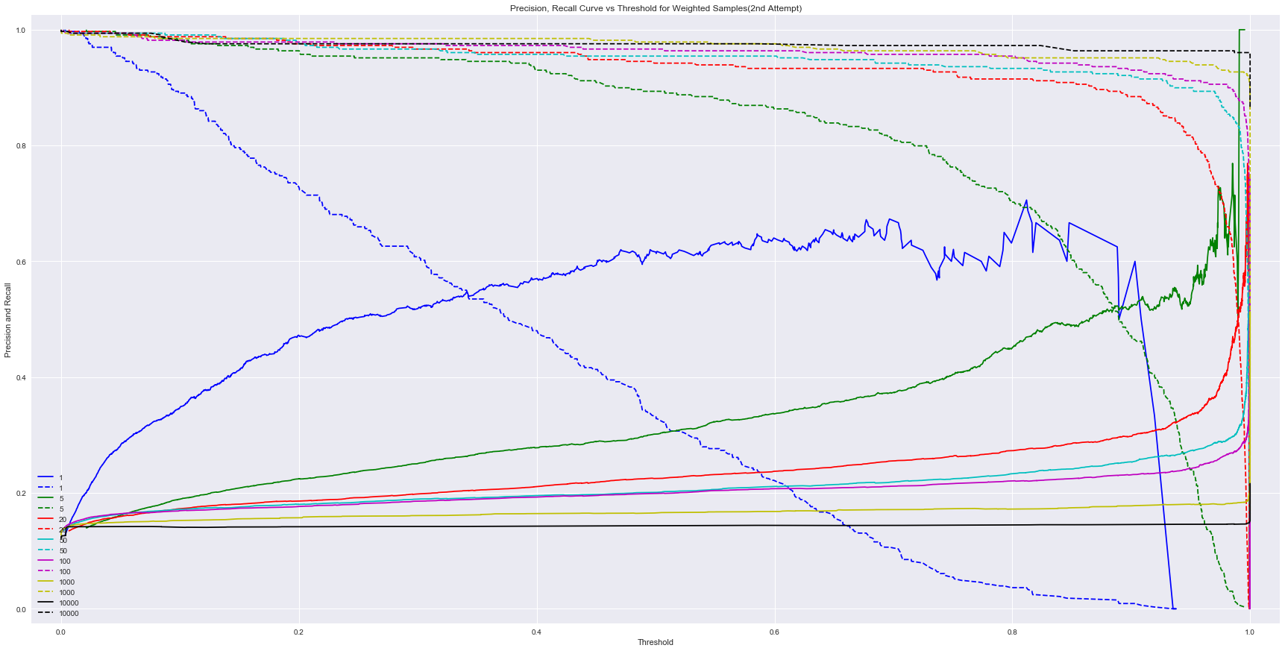
Weighted Class classifier (continue…)
Notes:
Since recall is important for our case,
Curves at the top for varying weights gives us recall for various weights.
Various threadhold is on x-axis and recall is on y axis.
First we choose the right threshold to balance recall and precision and then chose the best weights.
Note: higher weight doesn’t necessarily means better

Slide 37
Minority Over-Sampling and Majority Under-sampling
Idea is similar to Weighted class
Instead of giving higher weights, we just replicate a subset of random minority samples
Also we can under samples the majority class i.e don’t take all the samples from majority class
Notes:
Similar to weighted samples but just replicate (minority) or remove(majority) the samples

Slide 38
SMOTE algorithm (Synthetic Minority Oversampling Technique)
Intuitively, just replicating the minority sample sounds cheating.
So better approach is to have new synthetic samples created by interpolating and extrapolating the two or more samples.
The candidate samples for interpolation can come from majority or minority or the combination of them.
The suggestion by SMOTE is to use the samples on the decision boundary .
SMOTE Paper by V Chawla and etal: https://arxiv.org/pdf/1106.1813.pdf
Notes:
Time: 3 slides == 3 min

Slide 39
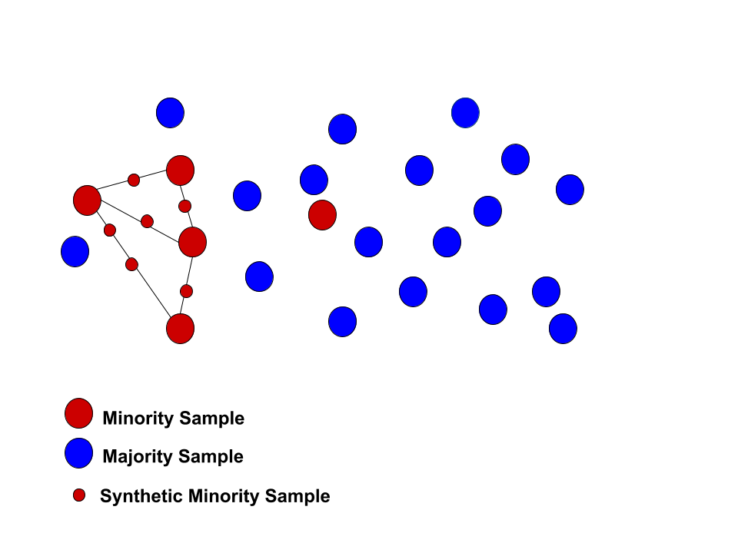
SMOTE (continue…)
Notes:
SMOTE:
Lets see this in the dataset with two dimensions
We interpolate the minority samples*big red circles) so that to produce small red circles as new synthetic samples.
The number of new samples between two samples is controlled by ‘dup_size’ parameter.

Slide 40
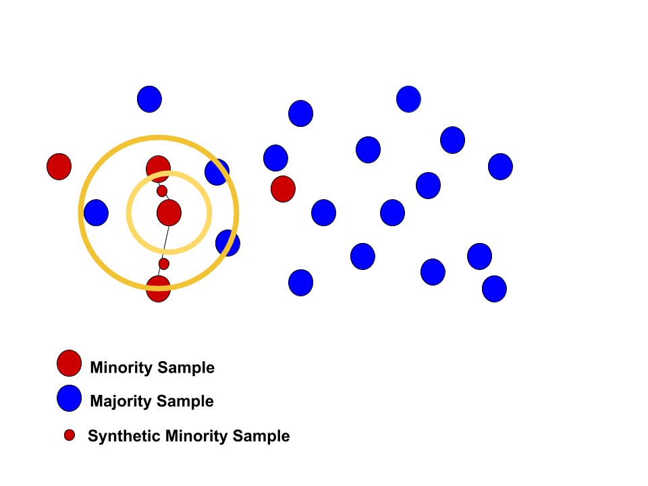
SMOTE(continue…)
Nearest neighbor minority samples synthesis.
For the center red circle for K=2, we have two neighbors and we have possibility of two synthesis samples for dup_size=1,
We randomly picks one of the small new red samples.
Notes:
-Nearest neighbor minority samples synthesis.

Slide 41
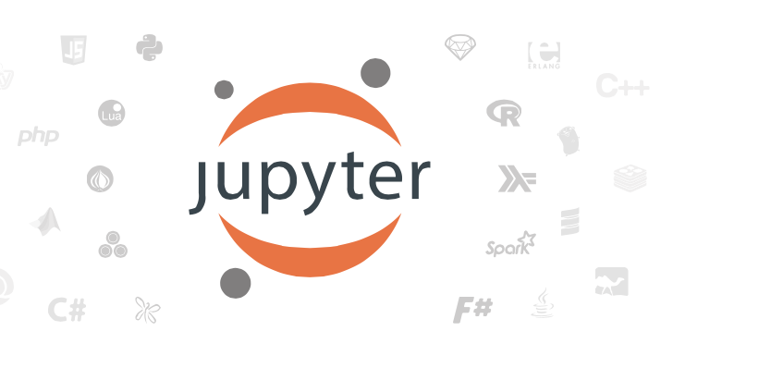
Demo for predictive classifier for imbalance datasets.
Notes:
NOTE:
At this time 25 mins should have passed
Next section 50 mins

Slide 42

Checklist
Look the package installation guide accompanying this tutorial.
Clone the github:
https://github.com/IBM/xgboost-financial-predictions/
Data: data/bank.csv
Notebook: notebooks/predict_bank_cd_subs_by_xgboost_clf_for_imbalance_dataset.ipynb
Slides: https://github.com/aloknsingh/ds_xgboost_clf_4_imbalance_data/slides
6) You can use one of the following platforms
a) Your laptop
b) IBM Watson Studio
Notes:
Notes:
Use IBM Watson for illustration
If internet is bad use, Anaconda Jupyter lab

Slide 43
Goto Notebook…
Notes:
Finish in 50 mins

Slide 44
Q/A
Notes:
Time : 10 min

Slide 45
Notes:
QA

